Slide 1


Key Insights and Recommendations
Social Buzz - Client Snapshot & Strategic Direction
Team Members:
Andrew Fleming - Chief Technical Architect
Marcus Rompton - Senior Principal
Yokesh Preethi S - Lead Analyst, Presenter

Slide 2


Today's agenda
Introduction
Project recap
Problem Statement
The Analytics team
Process Overview
Key Findings
Recommendations
Next Steps

Slide 3

Social Buzz, founded by two ex-engineers from a major social media firm, focuses on content-centric user engagement with over 500 million monthly active users. They handle vast amounts of unstructured data daily and need external expertise for three key reasons:
IPO Preparation: They seek guidance for a smooth IPO by year-end.
Scalability: They need help managing their rapid growth without expanding their team.
Best Practices: They want to adopt advanced data management practices
Project Recap

Slide 4

Problem
Social Buzz, a rapidly growing social media and content creation company, faces challenges due to its swift expansion and massive data volume. They require external expertise to address three critical needs:
IPO Readiness: Guidance is needed to prepare for a successful initial public offering by the end of next year.
Scalability Management: Assistance is required to effectively manage their large-scale operations and data without expanding their current team.
Data Management Best Practices: They seek to understand and implement best practices in big data management used by leading global corporations.

Slide 5



Yokesh Preethi S :
Lead Analyst, Presenter
The Analytics team
Marcus Rompton:
Senior Principal
Andrew Fleming:
Chief Technical Architect

Slide 6
Process
1
Data Understanding
2
Data Cleaning
3
Data Modeling
4
Data Analysis
5
Uncover Insight

Slide 7
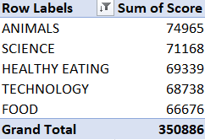

Key Findings
Identified gaps in current big data practices.
Weak spots in technology infrastructure revealed by stress testing.
Top 5 content categories with the largest aggregate popularity

Slide 8
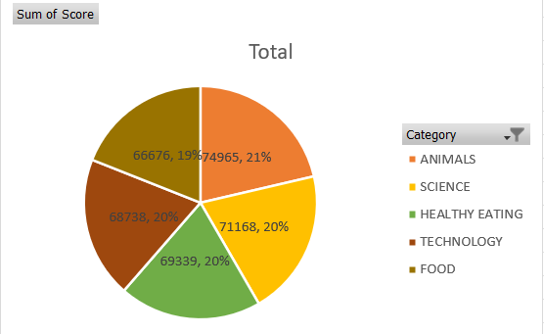
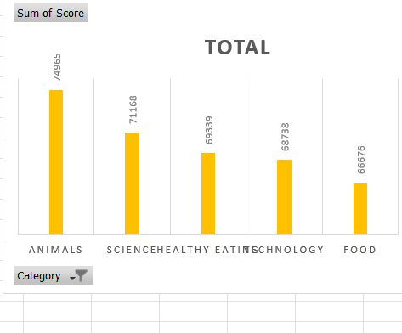

Slide 9
Recommendations
Conduct a Comprehensive Big Data Audit: Evaluate their current data infrastructure, management practices, and technology stack, and prepare an updated best practices presentation.
Prepare for IPO: Develop financial and operational readiness, ensure regulatory compliance, and create a compelling investor pitch deck, incorporating insights from previous IPO experiences.
Analyze Content Categories: Identify and visualize the top 5 most popular content categories based on engagement metrics to highlight trends and insights.
Optimize Technology Infrastructure: Perform stress testing to identify and address performance bottlenecks, and enhance the infrastructure for better scalability and efficiency.
Implement Continuous Improvement: Regularly review and refine data management processes, integrate best practices, and provide ongoing training to staff.

Slide 10
Next Steps
Short-term Actions:
Immediate implementation of best practices.
Conduct technology architecture workshop with Social Buzz Data Team.
Long-term Plan:
Ongoing support during IPO preparation.
Continuous monitoring and optimization of data management practices.
Follow-up:
Schedule further sessions for detailed guidance on IPO and data practices.

Slide 11

Objective: Evaluate system change impacts on performance metrics and deliver a comprehensive report with actionable recommendations.
Summary
Key Findings: Identified gaps in big data practices, weak spots in technology infrastructure, and top 5 popular content categories.
Recommendations & Next Steps: Apply best practices, optimize infrastructure, and prepare for the IPO with immediate actions and long-term support plans.

Slide 12
Thank you!
ANY QUESTIONS?

